Slide 1

The new and the old combined

Slide 2
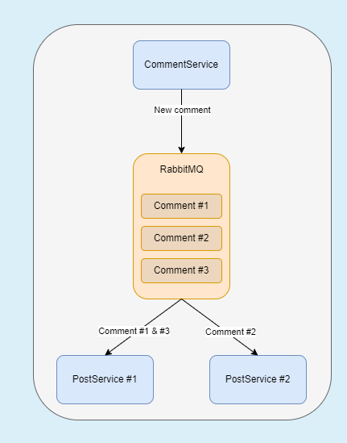
LO 4 – Scalable Architectures
Microservices
ServicePost
ServiceComment
ServiceImage
RabbitMQ
Async

Slide 3
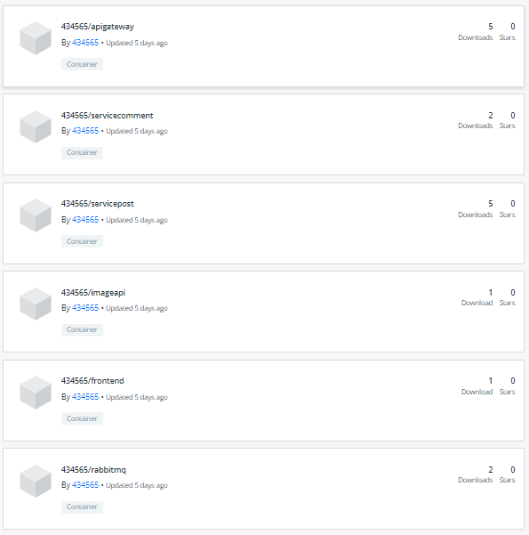

LO 5 – DevOps
Docker images
Docker compose
Kubernetes
Back end testing
GitHub CI/CD

Slide 4



LO 6 – Cloud services
Azure blob storage
Mongo DB Atlas
Auth0

Slide 5

LO 7 – Security by Design
Authenticatie
OWASP Top 10

Slide 6
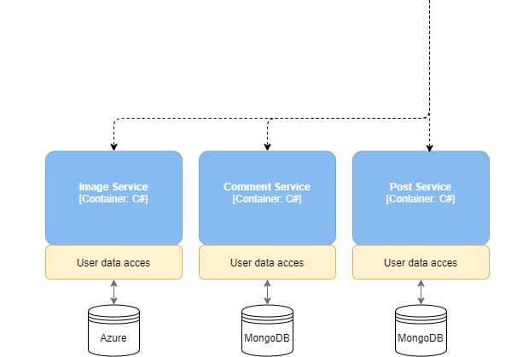
LO 8 – Distributed Data
Aparte databases
Blob storage
Encrypted data

Slide 7
Demo

Slide 8
Volgende sprint
Kubernetes
OWASP Top 10
Testen
GDPR
Verdere feedback

Slide 9
Vragen?

